Slide 1
Welcome,
Senior student,
to the exciting field of…
STATISTICS

Slide 2
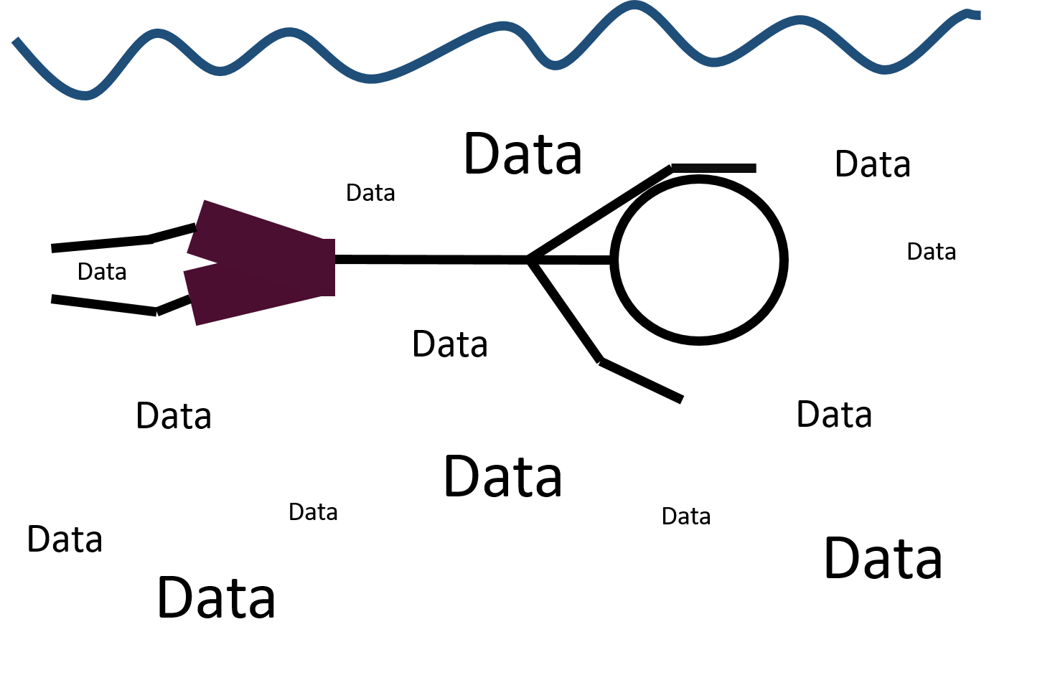
Our world today…
Source: Johan Coetzee

Slide 3
Statistics…
Data
Formulas
Code
+
+

Slide 4
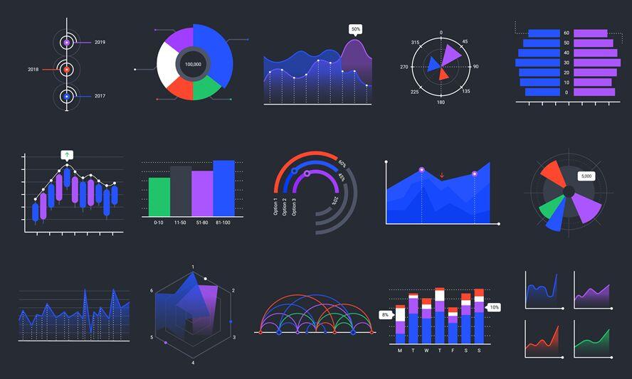
=
Information
that drives
decisions
Source: The Hungry JPEG

Slide 5
Statistics is relevant irrespective of what you study…
Marketer, entrepreneur, psychologist, teacher, nurse, etc
Everyone must be able to analyse data relevant to THEIR field of study!

Slide 6
To specialise in statistics you need…
A strong mathematical foundation
Good coding skills
Statistical theory
Statistical application
Communication skills

Slide 7
Which program…
Matric maths mark >= 70%?
YES
Normal
3 year BSc BMI* program
*Business Mathematics and Informatics
NO
Maths >= 60% AND
Physics >=50%
Normal
3 year BSc Stats & Computer Science
YES
Maths >= 50%
NO
YES
Extended
4 year program

Slide 8
BMI – three options…
Business Analytics/Data Mining/Data Science
Computer Science
Economics
Information Technology
Machine Learning
Mathematics & Applied Mathematics
Statistics
Include skills, technologies, applications and practices for continuous iterative exploration and investigation of huge data bases in order to gain insight and drive business planning.
Financial Mathematics
Applied Mathematics
Mathematics
Statistics
Financial Engineering
Stochastic Processes
Its numerous applications have become vital to the day to day functioning of the world’s financial institutions.
Quantitative Risk Management
Computer Science & Information Technology
Economics
Financial Mathematics
Mathematics
Risk Management
Statistics
Enterprise-wide Risk Management :
The most important risk types are market, credit and
operational risk.

Slide 9
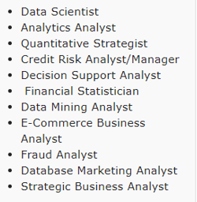
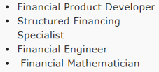
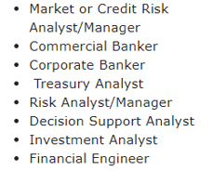
Job opportunities…
Business Analytics
Financial Mathematics
Quantitative Risk Management

Slide 10
Normal 3 year program
STTN115
Year 1
Semester 1
STTN125
Semester 2
STTN215
Semester 1
Year 2
STTN225
Semester 2
Semester 1
STTN316 & 317
Year 3
Semester 2
STTN326 & 327

Slide 11
Extended 4 year program
STTF115
Year 1
Semester 1
Semester 2
STTF125
STTF215
Semester 1
Year 2
STTF225
Semester 2
Semester 1
STTN215
Year 3
Semester 2
STTN225
STTN316 & 317
Semester 1
Year 4
STTN326 & 327
Semester 2

Slide 12
Normal (3 year) program – future modules
2nd year modules:
STTN215: Probability and Sampling Theory
STTN225: Statistical Inference and Data Analysis
3rd year modules:
STTN316: Linear Models I
STTN317: Statistical software and Applications I
STTN326: Analysis of Dependent Data
STTN327: Statistical Software and Applications II

Slide 13
Extended (4 year) program – future modules
2nd year modules:
STTF215: Practical Statistics
STTF225: Introduction to Probability
3rd year modules:
STTN215: Probability and Sampling Theory
STTN225: Statistical Inference and Data Analysis
4th year modules:
STTN316: Linear Models I
STTN317: Statistical software and Applications I
STTN326: Analysis of Dependent Data
STTN327: Statistical Software and Applications II

Slide 14
Prerequisites for modules
Module | Prerequisite
STTF215 (Extended program) | STTF125
STTF225 (Extended program) | STTF215 (40%) & MTHS111
STTN215 (Normal program) | STTN125 & MTHS111
STTN215 (Extended program) | STTF115, 125, 215 & 225
STTN225 | STTN215 (40%)
STTN316 | STTN225
STTN317 | STTN225
STTN326 | STTN225
STTN327 | STTN317 (40%)

Slide 15
How to pass your modules…
Ensure that you have internet for online learning.
Your lecturer will upload slides, videos, assignments, memo’s and communication to www.efundi.nwu.ac.za
Purchase the text book.
Work hard from DAY 1!
Practise every day.
Ask if you don’t understand.
Communicate via e-mail.
Ensure that you keep a positive attitude and do your best at all times!

Slide 16
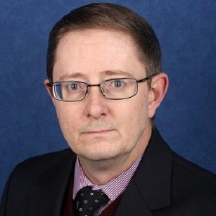
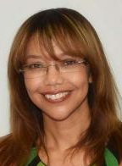
Your lecturers…
STTN215:
Dr J. de Klerk
Jacques.deKlerk@nwu.ac.za
STTN317:
Ms W. Coetzee
Wilma.Coetzee@nwu.ac.za
016 910 3281
Extended 4 year program
STTN316:
Mr Lethani Ndwandwe
Lethani.Ndwandwe@nwu.ac.za
016 910 3557
STTF215:
Ms C. Scrimnger-Christian
Charmaine.ScrimngerChristian@nwu.ac.za
016 910 3274

Slide 17
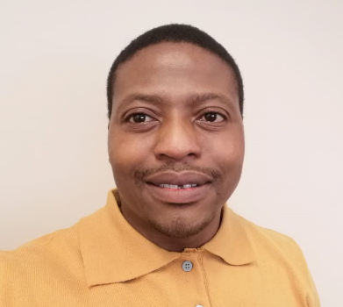
Management contact details…
Deputy group leader: Statistics
Dr M. Seitshiro
Modisane.Seitshiro@nwu.ac.za
016 910 3289
Director: School for Mathematical and Statistical Sciences
Prof. D. Kubayi
David.Kubayi@nwu.ac.za
016 910 3443

Slide 18
Success is the sum of small efforts, repeated day in and day out. You can do this!!!
Music Info: Corporate Inspiring - AShamaluevMusic.
Music Link: https://www.ashamaluevmusic.com/music-for-fashion

